Slide 1


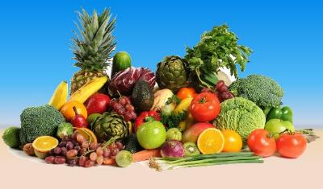
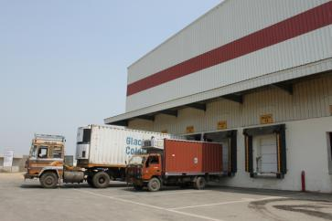
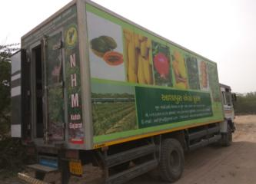


Horticulture Development including Cold-Chain
Department of Agriculture, Cooperation & Farmers Welfare

Slide 2







India’s Horticulture Scenario
↑ 84 %
↑ 74%
↑ 86%
↑ 133%
Only 16% of arable land under Horticulture (25.1 million hectares)
Produced 299.85 million tons in 2016-17
Contributes 30% to Gross Net Value of Agriculture
Fruit & vegetable availability per capita increase from 397 gm/day in 2004-05 to 540 gm/day in 2015-16
2nd largest Producer of Fruits & Vegetables globally
Exports increased by more than 3 times in 10 years
3rd Estimate
Others: includes Spices, Loose Flowers, Nuts, Mushroom, Aromatic/medicinal and Honey .
Source: Horticulture Division, Ministry of Agriculture and Analysis

Slide 3







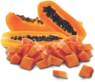













Fruits & Vegetable Snapshot
Vegetables:
Total Production 176.2 million MT (2016-17 3rd Estimate )
Average productivity 17.11 MT/ha
Fruits:
Total production 93.71 million MT (2016-17 3rd Estimate)
Average productivity 14.51 MT/ha

Slide 4
Major Producing States
Fruits
These states account for 74.51 % of production
Vegetables
These states account for 78% of production
(2016-17 3rd Estimate)

Slide 5

Growth in Exports of Horticulture
SN | Commodity | Value (Rs in crore) |  | % Increase
 |  | 2004-05 | 2015-16
1 | Fruits & Vegetables | 1363.71 | 8391.41 | 515.34
2 | Floriculture | 221.11 | 972.96 | 340.03
3 | Spices | 2627.62 | 14842.36 | 464.86
4 | Cashew* | 2709.24 | 5432.85 | 100.53
 | Total | 6921.7 | 28770.0 | 315.64
Scope for value realisation in domestic market is also growing.
Logistics connectivity to domestic urban centres also being developed.
*Cashew figures for 2013-14 (P)
Source: Directorate General of Commercial Intelligence

Slide 6
Post Harvest Losses
As per recent study by CIPHET, Harvest & Post Harvest losses including losses during storage for fruits and vegetables were in the range of 5% to 16%.
Stage of Post Harvest in Horticulture:-
S. No. | Stages | Range of losses (%)
 |  | Fruits | Vegetables
 | Operations
1. | Harvesting | 1.68 – 5.33 | 0.99 – 3.16
2. | Collection | 0.26 - 0.42 | 0.04 – 0.52
3. | Sorting/Grading | 1.46 – 3.94 | 0.99 – 5.34
4. | Packaging | 0.09 – 0.34 | 0.06 – 0.38
5. | Transport | 0.42 – 1.91 | 0.51 – 1.75
 | Total (A) | 4.12 – 11.90 | 3.22 – 9.41
 | Storage Channels
6. | Farm Storage | 0.01 – 0.23 | 0.05 - 0.66
7. | Cold Storage | 0.01 – 0.13 | 0.00 – 0.30
8. | Wholesale | 0.57 – 1.62 | 0.31 – 1.26
9. | Retail | 0.34 – 2.08 | 0.11 – 1.63
10. | Processing | 0.03 – 0.25 | 0.00 – 0.17
 | Total (B) | 1.31 – 3.98 | 0.78 – 0.03
 | Grand Total (A+B) | 6.70 – 15.88 | 4.58 – 12.44

Slide 7
Cold-chain Infrastructure Gap – NABCON’s study 2015
Type of Infrastructure | Infrastructure Requirement (A) | Infrastructure Created (B) | All India Gap (A-B) | % share of Gap to Required
Pack-house | 70,080 nos. | 249 nos. | 69,831 nos. | 99.6%
Reefer Vehicles | 61,826 nos. | 9,000 nos. | 52,826 nos. | 85%
Cold Storage (Bulk) | 341,64,411 MT | 318,23,700 MT | 32,76,962 MT | 10%
Cold Storage (Hub) | 9,36,251 MT
Ripening Chamber | 9,131 nos. | 812 nos. | 8,319 nos. | 91%
To understand the infrastructure requirement a comprehensive capacity study was undertaken in 2015, to help in planning and to rationalise the scheme

Slide 8
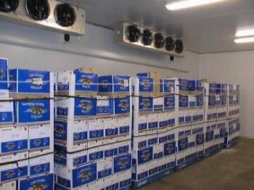
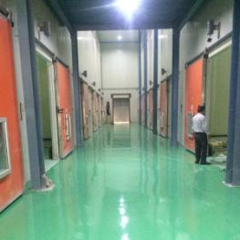
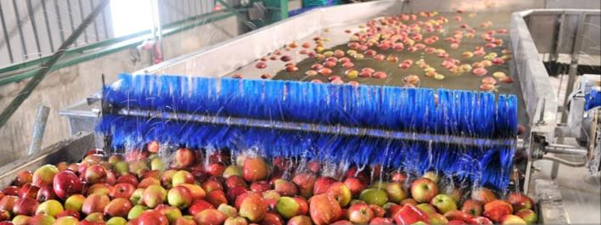
5 Year Plan for Cold-chain development
Rs. in Crore
S. N. | Component | Existing Capacity (2015) | Approximate Requirement in next 5 years | Funds required for five years as Government support
1. | Integrated Pack Houses | 250 numbers | 14,000 numbers | 2450.00
2. | Cold Room | -- | 20000 | 1050.00
3. | Cold stores (Bulk & distribution hubs) | 32.5 million tonnes | 2.5 million tonnes | 700.00
4. | Reefer Trucks | <10,000 numbers | 20,000 numbers | 1850.00
5. | Ripening Chambers | 800 numbers | 4000 numbers | 56.00
 | Total |  |  | 6106.00

Slide 9
Post-harvest components created under MIDH
(As on 31.07.2017)
S. N. | Components | Projects | Assistance (Rs. in Crore)
1. | Pack House/Aggregation point | 20710 | 287.83
2. | Pre – Cooling Unit | 101 | 6.26
3. | Reefer Vehicle | 411 | 28.66
4. | Cold Storage | 4421 (Capacity 20.87 million MT) | 2667.86
5. | Ripening Chamber | 443 | 111.54
6. | Primary processing units | 4257 | 180.11
7. | Low Cost Onion Storage | 12568 (Capacity 3.14 lakh MT) | 109.97

Slide 10
State wise & Agency wise distribution of Cold Storages
S. No. | Name of the State | Total
 |  | No. | Capacity (MT)
1 | Andaman & Nicobar Islands (UT) | 2 | 210
2 | Andhra Pradesh & Telangana | 432 | 1757785
3 | Bihar | 305 | 1416095
4 | Chandigarh (UT) | 7 | 12462
5 | Chhattisgarh | 98 | 484557
6 | Delhi | 97 | 129857
7 | Goa | 29 | 7705
8 | Gujarat | 773 | 2971729
9 | Haryana | 336 | 741446
10 | Jharkhand | 58 | 236680
11 | Karnataka | 195 | 556355
12 | Kerala | 197 | 79405
13 | Lakshadweep (UT) | 1 | 15
14 | Madhya Pradesh | 296 | 1269253
15 | Maharashtra | 581 | 896730
16 | Orissa | 170 | 538139
17 | Pondicherry (UT) | 3 | 85
18 | Punjab | 657 | 2157661
19 | Rajasthan | 162 | 533893
20 | Tamil Nadu | 168 | 316583
21 | Uttar Pradesh | 2285 | 14139098
22 | West Bengal | 511 | 5940511
A Total- |  | 7363 | 34186254
Continue…..

Slide 11
State wise & Agency wise distribution of Cold Storages
S. No. | Name of the State | Total
 |  | No. | Capacity (MT)
1 | Arunachal Pradesh | 1 | 5000
2 | Assam | 36 | 157906
3 | Himachal Pradesh | 63 | 119167
4 | Jammu & Kashmir | 38 | 124443
5 | Manipur | 1 | 3000
6 | Meghalaya | 4 | 8200
7 | Mizoram | 3 | 4471
8 | Nagaland | 2 | 6150
9 | Sikkim | 2 | 2100
10 | Tripura | 14 | 45477
11 | Uttrakhand | 45 | 151421
B- Total |  | 209 | 627335
Grand Total (A+B) |  | 7572 | 34813589

Slide 12
Sector and Commodity wise use of cold storage
95% of cold storage are owned and operated by private sector, 3% cooperative and remaining 2% are under PSUs.
75% - 80% cold storage capacity is used for potato .
7% of capacity is used for pharma products.
5% of capacity is used for processed foods.
5% of capacity is used other horticulture crops.
3% of available capacity is used for marine and meat products.

Slide 13
Challenges and Opportunities
Cold-chain support is designed as a demand driven activity.
Huge funding gaps: Rs. 6100 crores required in next five years.
Disproportionate focus on cold storage capacity limited to long term storage crops only.
Insufficient private sector investment.
Strengthening of integrated cold-chain will reduce post harvest losses, add to farmer’s income, stabilise prices, create near-farm jobs and quality produce to consumers.

Slide 14
Changing Focus; Component wise Allocation AAP2016-17 vs 2017-18
2016-17
2017-18 (Approved)
14

Slide 15
Road Map for PHM including Cold-Chain
Government has identified cold chain as a thrust area for development.
GoS recommendation for creation of cold-chain Infrastructure.
Crop and cluster specific value chain studies for forward linkages has been assigned to NLAs.
Empower existing asset owners to extend into other aspects of agri-business value chain.
Allocating 35% of MIDH budget for cold-chain and PHM infrastructure.
Enabling Farmer groups (FPO’s) to own Cold Chain.
Skill development through Institutional mechanism and boost knowledge dissemination /capacity building on cold-chain.

Slide 16
States Focus- Requested
Emphasis on quality planting material. (5%)
States have been requested to prepare a detailed 5 year plan on availability of planting material.
Accreditation of nurseries including floriculture nurseries, tissue culture lab, etc.
Traceability, Labeling & Tagging of Planting Material.
Development and import of processable varieties for Citrus, Potato, Tomato, Onion, Pineapple etc.
Special emphasis for Ripening Chamber for scientific ripening.
DBT compliance by all States- at the earliest (31st December, 2017).
Geo- tagging of assets created under MIDH.
16

Slide 17
States Focus- Requested
States may promote entrepreneurship and support startups in Horticulture Value Addition
Special thrust on creation of market linked cold-chain logistics and PHM facilities.
Focus on productivity through Protected cultivation. (25% of allocation)
Focus on aggregation of farmer producers and linking them to markets for economy of scale and better value realization.
States should upload monthly progress report on scheme implementation regularly.

Slide 18


End of Deck

Slide 19
Status of Value Chain Studies through NLA’s
8 National Level Agencies were assigned for studies on Value chain of 20 different crops namely;
- Fruits- Mango, Litchi, Banana, Orange, Grapes, Kinnow, Kiwi, Dragon Fruits, Passion Fruits, Apple, Peach, Walnut and Sea buckthorns etc
- Vegetables :- Tomato, Onion & Moringa etc
- Spices:- Turmeric
A draft report on following Crops received
Value chain Study on Grape- District- Nasik,Maharasthra
Value chain Study on Dragon Fruits- District- Mamit, Mizorum
Value chain Study on Peach- District- Nainital, Uttarakhand
Value chain Study on Mango- District- Rayagada, Odisha
Value chain Study on Mango- District- Chittor, Andhra Pradesh
Value chain Study on Fruits & Vegetables- District-Shimla, Himachal Pradesh
Value chain Study on Mango- District-Saharanpur, Uttar Pradesh
Value chain Study on Mango- District-Valsad, Gujarat
Other studies are in progress

Slide 20
Value chain mapping: NHM and NLAs
NLAs: Value Chain Study and Gap analysis, NHM: Value Chain Projects.
S. No. | State | Crop | Cluster | Study by NLA
1 | Andhra Pradesh | Mango | Chittor | NCPAH
2 | Bihar | Litchi | Muzaffarpur | NIAM
3 | Chhattisgarh | Tomato | Durg, Rajnandangaon, Raipur | NHRDF
4 | Goa | Cashew | North Goa | DCCD
5 | Gujarat | Mango | Valsad | NCPAH
6 | Gujarat | Banana | Navsari | NCCD
7 | Haryana | Tomato | Gharaunda | NHRDF
8 | Jharkhand | Tomato | Ranchi | NHRDF
9 | Karnataka | Onion | Chikmagalur | NHRDF
10 | Karnataka | Vegetable & Fruits | Mandya | HIL
11 | Kerala | Pepper | Idukki | Spices Board
12 | Madhya Pradesh | Orange | Agar Malwa | NRCC
13 | Maharashtra | Cashew | Konkan | DCCD
14 | Maharashtra | Grapes | Nashik | NCPAH
15 | Odisha | Mango | Raigad | NCPAH
16 | Punjab | Kinnow | Fazilka | NHRDF
17 | Rajasthan | Citrus | Jhalawar & Jaipur | NRCC
18 | Tamil Nadu | Moringa | Theni & Dindigul | NHRDF
19 | Telangana | Turmeric | Nizamabad, Warangal, Karimnagar, Adilabad | DASD
20 | Uttar Pradesh | Mango | Saharanpur | NCPAH
21 | West Bengal | Banana | Nadia | HIL

Slide 21
Value chain mapping HMNEH and NLAs
NLAs: Value Chain Study and Gap analysis, HMNEH: Value Chain Projects.
S. No. | State | Crop | Cluster | Study by NLA
1 | Arunachal Pradesh | Kiwi | Lower Subansiri | NIAM
2 | Assam | Ctrus | Boko | NRCC
3 | Manipur | Pineapple | Imphal | NIAM
4 | Meghalaya | Mandarin | East Karo Hills | NRCC
5 | Mizoram | Dragon Fruit | Reiek | NCPAH
6 | Nagaland | Passion Fruit | Mokakchung & Wokha | HIL
7 | Sikkim | Orange | Dzongri | NRCC
8 | Tripura | Pineapple | Dhalai & Unokotti | NIAM
9 | Jammu & Kashmir | Walnut & Seabuckthorn | Anantnag Leh | Spices Board DASD
10 | Himachal Pradesh | Apple | Narkanda | NCPAH
11 | Uttarakhand | Peach | Ramgarh | NCPAH

Slide 22
PHM Infrastructure to be created in 2017-18
S.N. | State | Cold Storage units |  |  | Refrigerated Transport Vehicles (9 MT) -(No.) |  | Ripening Chamber -(No.)
 |  | PT | Capacity (MT) | PA | PT | PA | PT | PA
1 | Gujarat | 39 | 195000 | 22 | 10 | 3 | 8 | 4
2 | Karnataka | 7 | 35000 | 0 | 5 | 1 | 50 | 0
3 | Madhya Pradesh | 12 | 60000 | 11 | 1 | 0 | 3 | 0
4 | Maharashtra | 6 | 30000 | 0 | 10 | 0 | 10 | 0
5 | Odisha | 6 | 30000 | 0 | 6 | 0 | 5 | 0
 | Total | 70 | 350000 | 33 | 32 | 4 | 76 | 4
 | All India |  | 8 Lakh MT

Slide 23
Last 3 year’s Achievements : NHM/HMNEH :
Major Components | 2014-15 | 2015-16 | 2016-17 | 2017-18* | Cumulative#
Area Coverage (ha) | 139809 | 138658 | 111489 | 26523 | 35,29,483
Rejuvenation of Orchards (ha) | 44620 | 17487 | 10850 | 929 | 6,50,943
Integrated Pest Management -ha | 103043 | 75497 | 80216 | 22099 | 16,60,552
Protected Cultivation (ha) | 26189 | 32043 | 34321 | 6328 | 2,02,308
Organic Farming (ha) | 13181 | 5460 | 5063 | 0 | 2,71,377
Nurseries (Nos.) | 97 | 62 | 70 | 17 | 4,494
Water Resources (Nos.) | 6513 | 4882 | 3786 | 446 | 93,052
Post Harvest Infrastructure (Nos.) | 9178 | 8622 | 7554 | 553 | 71,213
Markets Infrastructures (Nos.) | 246 | 452 | 881 | 29 | 2973
* As on 14.09.2017
# Since 2005-06

Slide 24
Phy. Target & Achievement - NHM 2017-18
STATE | Area Coverage (ha) |  | Rejuvenation (ha) |  | IPM (ha) |  | Protected Cultivation (ha)
 | Target | Achmt | Target | Achmt | Target | Achmt | Target | Achmt
Andaman & Nicobar | 96 | 0.85 | 30 |  |  |  | 5.11
Andhra Pradesh | 9824 | 1006.02 | 1143 | 210 |  |  | 6923.12 | 165.33
Bihar | 3517 | 91.23 | 25 |  | 5000 |  | 2017
Chhattisgarh | 8896 | 4470 | 1000 |  | 1000 |  | 9246 | 4568.1
Goa | 132 |  |  |  |  |  | 0.95
Delhi | 452 |  | 280 |  |  |  | 24
Gujarat | 6592.3 | 527.9 | 1000 |  |  |  | 2047.91 | 311.78
Haryana | 6300 | 748.59 | 120 | 5.3 | 7000 | 3335.08 | 326.11 | 53.59
Jharkhand | 8304 |  | 50 |  |  |  | 197.6
Karnataka | 5466 | 2662.39 | 645 | 253 | 23083 | 14334.03 | 1011 | 418.24
Kerala | 6071 | 198.57 | 200 | 50.42 |  |  | 62.6 | 7.21
Madhya Pradesh | 3760 |  | 1000 |  | 1000 |  | 2130
Maharashtra | 1894.5 |  | 400 |  |  |  | 496.41
Odisha | 9965 | 900 | 250 |  | 1500 |  | 1244.35 | 130.35
Puducherry | 165 |  | 10 |  |  |  | 10.15
Punjab | 1500 |  | 500 |  | 5000 |  | 54
Rajasthan | 7250 | 2158 | 1000 |  | 1000 |  | 318.95 | 35.04
Tamil Nadu | 8595 | 4672.8 | 735 | 345.45 | 3250 | 1240 | 1864.24 | 605.1
Telangana | 2590 | 1183.68 |  |  |  |  | 53.49 | 0.8
Uttar Pradesh | 3800 | 2065 | 250 |  |  |  | 41.9 | 5.84
West Bengal | 4240 |  | 600 |  |  |  | 79.1
Total | 99409.8 | 20685.03 | 9238 | 864.17 | 47833 | 18909.11 | 28153.99 | 6301.38
** Status of Progress for the Year 2017-18 is upto 16th September’2017
Contd..

Slide 25
Phy. Target & Achievement - NHM 2017-18
STATE | Nurseries (Nos.) |  | Water Resource (Nos) |  | PHM (Nos.) |  | Market (Nos.)
 | Target | Achmt | Target | Achmt | Target | Achmt | Target | Achmt
Andaman & Nicobar | 2 |  |  |  | 2 |  | 2
Andhra Pradesh | 24 |  | 371 | 87 | 851 | 31 | 32
Bihar | 1 |  |  |  | 442 | 8 | 37
Chhattisgarh | 8 |  | 111 |  | 585 |  | 231
Goa
Delhi | 3 |  |  |  | 8 |  | 5
Gujarat | 2 |  |  |  | 100 | 36 | 68 | 11
Haryana |  |  | 81 | 65 | 119 | 45 | 157 | 7
Jharkhand | 6 |  | 11 |  | 536 |  | 327
Karnataka | 7 |  | 640 | 225 | 1192 | 179 | 151 | 8
Kerala | 7 | 1 | 106 | 16 | 399 | 8 | 13 | 2
Madhya Pradesh | 2 |  |  |  | 68 | 11 | 100
Maharashtra | 2 |  | 437 |  | 612 |  | 30
Odisha | 5 |  | 305 | 3 | 1604 | 21 | 50
Puducherry |  |  |  |  | 2 |  | 10
Punjab | 1 |  | 10 |  | 89 |  | 6
Rajasthan | 7 |  | 85 | 19 | 436 | 57 | 26
Tamilnadu | 19 |  | 105 |  | 1105 |  | 175
Telangana | 4 | 4 | 100 | 24 | 137 | 81 | 2
Uttar Pradesh | 1 |  |  |  | 78 | 6 | 12
West Bengal | 6 |  | 45 |  | 81
Total | 107 | 5 | 2407 | 439 | 8446 | 483 | 1434 | 28
** Status of Progress for the Year 2017-18 is upto 15th September’2017

Slide 26
Phy. Target & Achievements - HMNEH 2017-18
STATE | Area Expansion (ha.) |  | Rejuvenation (ha.) |  | IPM (ha.) |  | Protected Cultivation (ha.)
 | Target | Achmt | Target | Achmt | Target | Achmt | Target | Achmt
Arunachal Pradesh | 1100 |  | 500 |  | 7000 |  | 413
Assam | 808 |  | 100 |  | 500 |  | 709
Manipur | 1910 |  | 250 |  | 1000 |  | 430
Meghalaya | 1421 | 770 | 150 |  |  |  | 82
Mizoram | 977 | 638 | 500 |  | 16663 | 8334 | 245 | 4
Nagaland | 2480 | 2480 | 115 | 115 | 3190 | 3190 | 13
Sikkim | 2665 | 1721 | 100 |  | 1500 |  | 63
Tripura | 2147 | 25 |  |  |  |  | 118
Himachal Pradesh | 979 |  |  |  |  |  | 140
Jammu & Kashmir | 1879 |  | 1000 |  | 1000 |  | 33
Uttarakhand | 2678 | 363 | 350 |  |  |  | 261 | 30
Total | 19044 | 5997 | 3065 | 115 | 30853 | 11524 | 2505 | 34
** Status of Progress for the Year 2017-18 is upto 15th September’2017

Slide 27
Phy. Targets & Achievements HMNEH- 2017-18
STATE | Nurseries (Nos.) |  | Water Resources (Nos.) |  | PHM (Nos.) |  | Markets (Nos.)
 | Target | Achmt | Target | Achmt | Target | Achmt | Target | Achmt
Arunachal Pradesh | 6 |  | 131 |  | 89 |  | 115
Assam | 8 | 11 | 30 |  | 20 |  | 42
Manipur | 6 |  | 207 |  | 50 |  | 3
Meghalaya | 10 |  | 205 |  | 291 |  | 14
Mizoram |  |  | 184 |  | 234 |  | 208
Nagaland | 1 | 1 |  |  | 519 | 71 | 12 | 12
Sikkim | 5 | 1 | 228 |  | 198 |  | 53
Tripura | 1 |  | 8 |  | 39 |  | 61
Himachal Pradesh | 3 |  | 102 |  | 58 |  | 9
Jammu & Kashmir | 17 |  | 91 |  | 394 |  | 100
Uttarakhand | 6 |  | 75 |  | 142 |  | 51
Total | 63 | 13 | 1261 |  | 2034 | 71 | 668 | 12
** Status of Progress for the Year 2017-18 is upto 15th September’2017

Slide 28

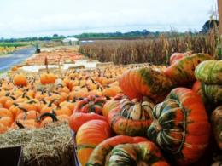
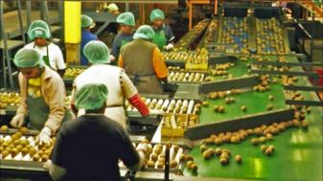
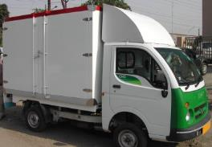
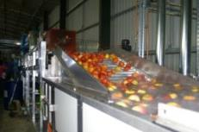
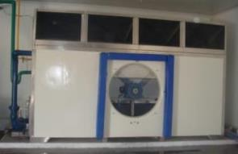
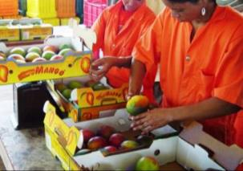
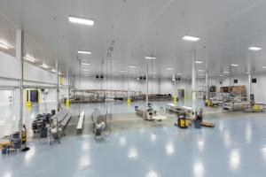
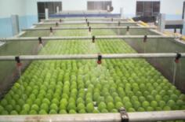
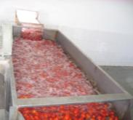

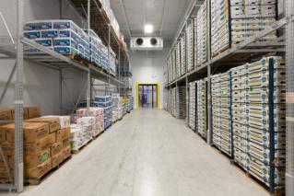
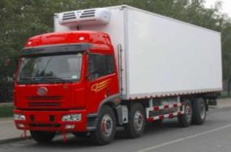


Cold-chain an overview
Sorting/ Grading
Sort / Aggregate
Transport
Harvest at Farms
Cleaning/
Treating
Pre-cool & Dispatch
Prepare - Package - Brand
Cold Storage
Long-Haul & Distribution
Retail

Slide 29
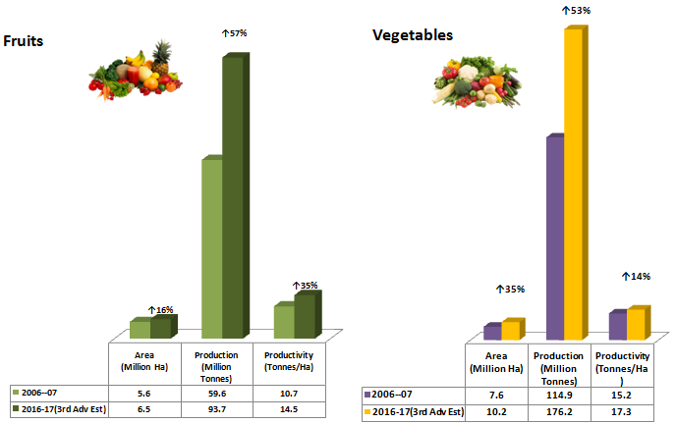
Area, Production and Productivity

Slide 30
Financial assistance for cold-chain under MIDH
Credit linked back ended subsidy @ 35% of the project cost in general areas and 50% in case of hilly and schedule areas is available.
S. No. | Components | Maximum Admissible Cost/Unit (Rs. in Lakh)
1 | Pack House | 4.00
2 | Integrated Pack House | 50.00 for 16MT/day
3 | Pre – Cooling Unit | 25.00 for 6 MT/batch
4 | Mobile pre-cooling unit | 25.00 capacity
5 | Reefer vehicle | 30.00 for 15MT
6 | Reefer Container (multi-modal) | 6.00 for 9MT
7 | Primary processing units | 25.00
8 | Ripening chamber | 1.00/MT for maximum 300 MT
9 | Cold Storage Type – I @ Rs. 8000.00/MT | 680.00 for maximum 10000 MT
10 | Cold Storage Type – II @ 10000/MT | 850.00 for maximum 10000 MT
11 | Low energy cool chamber (100 kg) | 0.04 per unit
12 | Temperature controlled retail units | 10.00 per establishment
Support for modernization of existing infrastructure, Add-on-component for CA storage, alternate energy and energy saving systems are also provided.
Technical norms in the form of minimum system standards are developed, also used by other agencies.
Notes:
Short harvest cycles brings lowered risk compared to field crops with single or twice a year harvest.

Slide 31
MIDH Financials at a Glance FY 2017-18
Rs. In crores
Sl. No | Name of the scheme | BE 207-19 | Funds released by IFD | Remarks
1 | Integrated Dev. Of Coconut Industry in India Including Tech. Mission on Coconut implemented by Coconut Dev. Board, Kochi (CDB). | 196.00 | 98.00 (50%)
2 | National Horticulture Board schemes (NHB) | 600.47 | 300.24 (50%)
3 | Central Institute of Horticulture (CIH) | 9.25 | 0.77
 | Total Central Sector component of MIDH | 809.60 | 400.29 | 49.44%
4 | Horticulture Mission for North East and Himalayan States (HMNEH) | 352.00 | 109.25 (31.03%)
5 | National Horticulture Mission (NHM) | 1002.53 | 335.71 (33.49%)
6 | National Agro-forestry and Bamboo Mission (NABM) | 15.00 | 4.32 (28.8%)
7 | PM’s Development Package for J&K | 150.00 | 75.00 (50%)
 | Total Centrally Sponsored component of MIDH | 1519.53 | 524.28 | 34.50%
 | Total (MIDH) | 2329.13 | 924.57 | 39.69%

Slide 32
National Horticulture Mission : State wise Allocation
(Rs. in crore)
S. No. | State/ | 2014-15 |  | 2015-16 |  |  | 2016-17 (as on 20/03/2017)
 | Implementing Agency | Allocation (GOI) | Releases | Allocation (GOI) | Releases | Unspent | Allocation (GOI) | Releases
1 | Andhra Pradesh | 74.59 | 64.68 | 71.50 | 55.75 | 29.61 | 64.03 | 64.02
2 | Bihar | 42.50 | 17.00 | 28.50 | 4.00 | 0.00 | 26.31 | 17.96
3 | Chhattisgarh | 120.70 | 111.88 | 80.00 | 77.55 | 17.33 | 69.23 | 51.47
4 | Goa | 4.68 | 0.00 | 3.00 | 2.30 | 0.87 | 2.52 | 1.65
5 | Gujarat | 130.90 | 109.47 | 78.71 | 47.82 | 10.01 | 71.39 | 65.45
6 | Haryana | 112.20 | 65.45 | 71.50 | 50.75 | 10.30 | 61.84 | 54.55
7 | Jharkhand | 68.00 | 49.69 | 45.00 | 25.79 | 9.86 | 40.18 | 30.13
8 | Karnataka | 124.95 | 96.08 | 81.50 | 67.69 | 5.49 | 72.97 | 67.17
9 | Kerala | 85.00 | 40.00 | 40.50 | 25.00 | 11.29 | 46.42 | 10.00
10 | Madhya Pradesh | 93.50 | 42.23 | 51.00 | 40.50 | 14.18 | 45.35 | 35.62
11 | Maharashtra | 158.95 | 140.00 | 102.50 | 96.25 | 15.87 | 88.97 | 40.44
12 | Orissa | 93.50 | 71.75 | 57.50 | 54.45 | 12.33 | 49.91 | 43.68
13 | Punjab | 70.13 | 58.50 | 46.00 | 30.35 | 11.08 | 39.86 | 30.00
14 | Rajasthan | 89.25 | 42.67 | 55.00 | 45.00 | 24.31 | 50.89 | 43.13
15 | Tamil Nadu | 107.95 | 55.36 | 61.50 | 58.73 | 24.41 | 55.03 | 32.14
16 | Telangana | 59.71 | 45.00 | 40.50 | 35.25 | 21.93 | 32.90 | 20.96
17 | Uttar Pradesh | 68.00 | 37.32 | 40.00 | 22.00 | 7.44 | 37.27 | 29.96
18 | West Bengal | 42.50 | 18.74 | 28.50 | 28.00 | 19.97 | 24.91 | 8.00
19 | Delhi | 2.55 | 0.00 | 0.50 | 0.00 | 0.36 | 0.50 | 0.00
20 | Puducherry | 1.70 | 0.86 | 1.00 | 0.50 | 0.16 | 1.00 | 0.50
21 | A & N Islands | 5.00 | 1.42 | 5.00 | 2.50 | 2.72 | 2.00 | 0.00
22 | Lakshadweep | 1.00 | 0.00 | 1.00 | 0.00 | 0.00 | 0.80 | 0.00
23 | Dadra & Nagar Haveli | 1.11 | 0.00 | 1.00 | 0.00 | 0.00 | 0.50 | 0.00
 | Sub Total | 1558.37 | 1068.10 | 991.21 | 770.18 | 249.52 | 886.78 | 647.33

Slide 33
National Horticulture Mission : State wise Allocation
(Rs. in crore)
 | States | 2014-15 |  | 2015-16 |  |  | 2016-17 (as on 20/03/2017)
 |  | Allocation (GOI) | Release | Allocation (GOI) | Release | Unspent | Allocation (GOI) | Release
1 | Arunachal Pradesh | 50.00 | 23.77 | 35.50 | 35.50 | 21.10 | 32.30 | 0.00
2 | Assam | 48.00 | 29.09 | 30.50 | 20.00 | 4.16 | 28.00 | 12.00
3 | Manipur | 50.00 | 44.17 | 37.50 | 35.75 | 18.27 | 32.00 | 10.00
4 | Meghalaya | 40.00 | 27.60 | 28.00 | 18.00 | 28.24 | 25.50 | 12.75
5 | Mizoram | 52.00 | 41.00 | 34.50 | 34.50 | 00.0 | 31.50 | 31.50
6 | Nagaland | 52.00 | 34.76 | 34.50 | 17.25 | 15.69 | 31.50 | 10.00
7 | Sikkim | 49.00 | 44.50 | 34.50 | 33.25 | 3.86 | 30.50 | 25.25
8 | Tripura | 54.00 | 37.00 | 37.50 | 32.75 | 7.65 | 33.00 | 23.50
9 | Jammu & Kashmir | 60.00 | 45.00 | 61.78 | 52.00 | 17.86 | 46.00 | 96.09
10 | Himachal Pradesh | 48.00 | 42.42 | 31.50 | 24.49 | 34.19 | 32.00 | 21.25
11 | Uttarakhand | 46.00 | 32.73 | 22.50 | 22.50 | 15.69 | 31.00 | 47.50
 | Total | 549.00 | 402.02 | 388.28 | 325.99 | 166.71 | 353.30 | 289.84

Slide 34
Targeted Development and beneficiaries
Type of Infrastructure | Target Beneficiaries
Modern Pack-house | Farmers, Entrepreneurs, FPOs, Cooperatives, Traders, Retailers, Logistics Service Providers, Mega Food Park promoters, agri-produce exporters
Cold Storage (Bulk) | Farmers, Entrepreneurs, FPOs, Traders, Wholesalers, Logistics Service Providers
Cold Storage (Hub)
Reefer Transport | Rural Youth, Logistics Service Providers, Pack-house and cold storage owners
Ripening Chamber | Retailers, Cold store Hubs, Logistics Service Providers

Slide 35
Challenges and Opportunities
Cold-chain support is designed as a demand driven activity undertaken by commercial interest.
Huge funding gaps: Sampda scheme with 6000 crore
Disproportionate focus on cold storage capacity limited to long term storage crops only.
Insufficient private sector investment.
Strengthening of integrated cold-chain will reduce post harvest losses, add to farmer’s income, stabilise prices, create near-farm jobs and quality produce to consumers.

Slide 36
MIDH : Changing Focus
Ensuring Quality : New technologies – trellis, precision farming, Protected cultivation quality planting materials on clonal rootstock – 30 % of MIDH budget
Reducing post harvest losses : Strengthening cold chain network, inducting technologies in post production handling – 35-40 % of MIDH budget
Value addition : Crop and cluster based value chain enhancement projects- 10% of MIDH budget

Slide 37
Actionable points
Major Concerns
ACTIVITIES to support
Quality planting material
Nurseries and accreditation, Tissue culture
Seed infrastructure, import of new varieties
Post harvest infrastructure development
Strengthening cold supply chain
Aggregation of farmers into FPOs
Linking farmers/FPOs directly to market
Identifying and strengthening crop specific value chain
Engaging farmers/FPOs in each leg of value chain
Protected cultivation, organic farming, micro irrigation, GAP, climate resilient crop varieties, etc.
Post harvest Losses
Market linkages and supply chain.
Increasing farmer’s income
Sustainable farming

Slide 38
Strategy for Cold-chain Development
Linking productivity efforts with market linkage by way of cold-chain and PHM targets.
Crop and cluster specific value chain enhancement projects.
Empower existing asset owners to extend into other aspects of agri-business value chain.
Allocating 35-40% of MIDH budget for cold-chain and PHM infrastructure.
Enabling Farmer groups (FPO’s) to own Cold Chain.

Slide 39
MIDH : Changing Focus
From increasing Production to quality, marketability, value chain enhancement, and market linkages
Supply side robustness is reflected in continued subdued pricing of fruits and vegetables and occasional glut situation
Hence, MIDH now focuses more on Post harvest management, protected cultivation,.
Focus on quality planting materials for processable and exportable varieties,
Market linkages to producers.

Slide 40
Reasons for Losses specific to Perishables
Inadequate cold-chain capacity for perishable other than milk, meat, and (pharmaceuticals).
Existing surface cold storage capacity is inadequate (only 11% of production).
Surface cold storage is largely dedicated to potato (75.4% of available cold stores).
Low availability of multi-commodity cold stores (23.1% of cold stores).
Non-availability of refrigerated transport from point of harvest to point of sale.
The gap is large in case of pre-cooling, Integrated pack-houses, transport connectivity and ripening chambers.

Slide 41
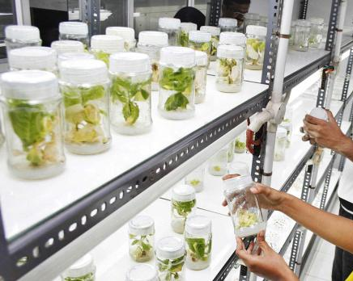
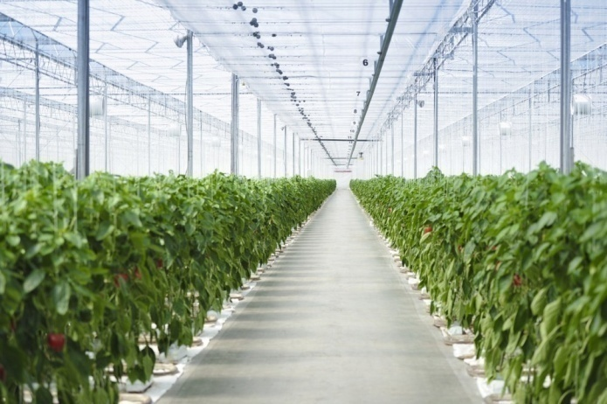
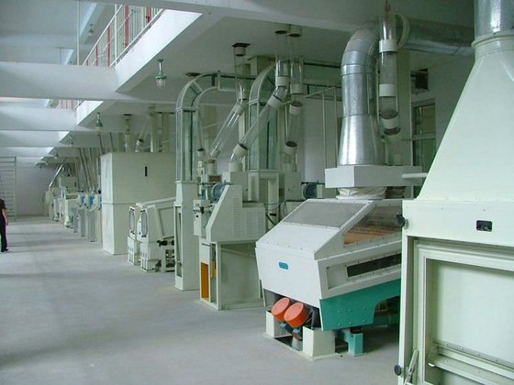
Funding Pattern
Centrally Sponsored Schemes:
State contributes 40% in NHM and 10% in HMNEH
100% central contribution to UTs and National Level Agencies
Higher pattern of assistance in HMNEH (NE and Himalayan) areas
Central Sector Schemes:
100% support by Central govt.
NHB, CDB and CIH with pan-India approach

Slide 42
Major Interventions under MIDH:
Production of quality planting material: Nurseries, Tissue culture labs, seed infrastructure, hybrid seeds, import of planting materials.
Area expansion i.e. Establishment of new orchards and gardens for fruits, flowers, and hybrid vegetables.
Protected cultivation, i.e. poly-house, green-house, shade-nets, etc. for growing off -season high value vegetables and flowers.
Creation of water resources structures and watershed management.
Creation of market linked cold-chain logistics and PHM facilities.
Rejuvenation of unproductive, old, and senile orchards.
Sustainable development by way of water management practices, organic farming certification

Slide 43
FLORICULTURE – an emerging sector in India
328 thousand ha. Area.
Production 1695 thousand MT of loose flowers
582 thousand MT Cut flowers(2016-17 3rd Estimate).
Exported 22,947.23 MT of floriculture products worth of Rs. 460.75 crores in 2014-15
77% of area under floriculture is concentrated in 7 states: TN, KN, AP, WB, HY, UP & Delhi.
Share in international market is 0.6%.
Huge domestic and international demand.
Need PHM and logistic support for quickest evacuation.

Slide 44
APICULTURE : a sweeter, better future
Production - 95000 MT Per Year
Export / Domestic Consumption 50% : 50%
Potential to keep about 120 million bee colonies employment - 6 million rural and tribal families.
Can produce over 1.2 million tons of honey and about 15,000 tons of beeswax
Exported 38177.08 MT of Natural Honey to the world for the worth of Rs. 705.87 crore during the year of 2015-16.
Major Export Destinations (2015-16) are United States, Saudi Arabia, United Arab Emirates, Morocco and Bangladesh
500 flowering plant species and 4 species of honey bees and 3 stingless bees.

Slide 45
Mushroom – room for expansion
Produces around 700 million tonnes crop residues –can be utilized for mushroom cultivation.
Only 0.03% of these residues for producing around 1.2 lakh tonnes of mushrooms resulting in less than 1% of the total world mushroom production.
Material left after cultivating mushrooms can be ploughed back in improving the soil health.
2% agro-residues can produce around 15.0 million tonnes, which will be more than double of the current global button mushroom production
China 60 types of mushrooms 80% of the global production.
In India we cultivate only four types of mushrooms on commercial
Marketing not well organized and less awareness in public.

Slide 46
Sub-scheme break-up of BE (plan) FY 2017-18
(Rs. in crore)
Central Sponsored Schemes (CSS) | BE (Plan)
1. National Horticulture Mission (NHM) | *1018.00
2. Horticulture Mission for North East and Himalayan States (HMNEH) | 352.00
3. PM’s Development Package for J & K | 150.00
Total (CSS) | 1520.00
Central Sector Scheme (CS)
4. National Horticulture Board (NHB) | 600.47
5. Coconut Development Board (CDB) | 196.00
6. Central Institute of Horticulture (CIH) | 5.00
Total (CS) | 801.47
Grand Total (CSS + CS) | 2321.47
* Out of which Rs. 90 Crore is meant for NLAs & UTs (100% GOI share)

Slide 47
NHB-Progress
S.N | Name of Component | Unit | Cumulative Achievement | 2017-18 | 2018-19 | 2019-20
1 | Area Expansion | Ha | 100479 | 3200 | 3280 | 3320
2 | Protected Cultivation | Ha | 4114 | 720 | 800 | 840
3 | New Nurseries | Nos. | 20 | 10 | 11 | 12
4 | Post-Harvest Management
 | a)- Cold Storage (CA storage) | MT | 135 Lakh MT | 3.0 Lakh MT | 3.25 Lakh MT | 3.5 Lakh MT
 | b)- Ripening Chamber | Nos. | 91 | 60 | 65 | 75
 | c)- Pack house/Grading Packing centre | Nos. | 254 | 170 | 192 | 205
 | d)- Precooling Unit/ Cold room | Nos. | 11 | 15 | 16 | 20
 | e)- Refer van | Nos. | 195 | 10 | 160 | 185
 | f)- Primary Processing | Nos. | 1172 | 150 | 155 | 160
5 | Mushroom, Tissue culture lab, Vermi-compost, Beekeeping, Mechanization etc | Nos. | 607 | 40 | 42 | 48
6 | Accreditation of Nurseries | Nos. | 1610 | 305 | 325 | 350

Slide 48
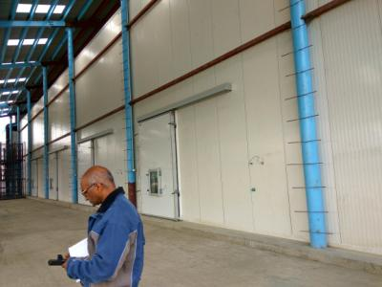
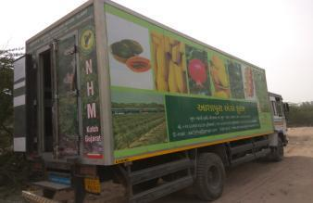
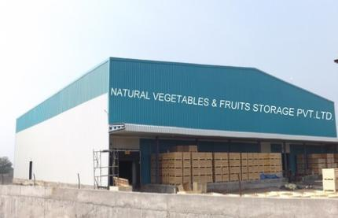
Cold-chain in Horticulture
Cold-chain is an environment controlled logistics chain, ensuring uninterrupted market link from farm to fork.
Cold-chain includes near farm pack-houses for pre-conditioning (sorting grading packing pre-cooling) reefer vehicles, cold storages, ripening chamber, etc.
In Horticulture, cold-chain strengthens the value chain system by enhancing marketability of the perishable produce & reducing food loss in the supply chain.
Cold-chain can play an important role in doubling farmer’s income by improving saleability of the produce and bringing more production to markets.
Notes:
Short harvest cycles brings lowered risk compared to field crops with single or twice a year harvest.

Slide 49
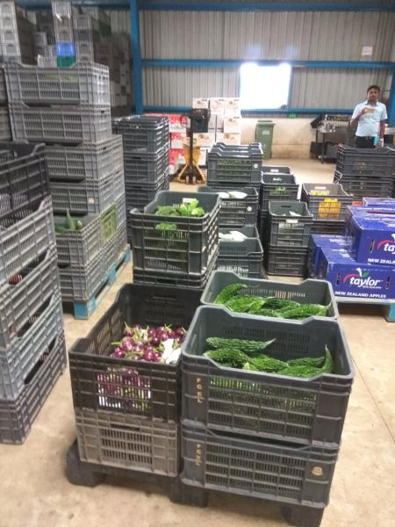
Initiatives for development of Cold-chain
Mission for Integrated Development of Horticulture (MIDH) provides incentives for creation of cold chain infrastructure which includes Pre-cooling, Pack house, Staging Cold Room, Reefer transport, Cold/CA Storage, Ripening Chamber and Retail outlets to link farm produce to the consumers for which 35% of resources have been allocated.
FPO’s have been promoted to create production clusters with Cold Chain Infrastructures
Notes:
Short harvest cycles brings lowered risk compared to field crops with single or twice a year harvest.

Slide 50
Mandate of NHB
Promote high quality commercial horticulture farms
Develop post-harvest management and cold-chain infrastructure
Development and Transfer of Technology for the promotion of Horticulture
Accreditation of Horticulture Nurseries
Promotion of mechanization in horticulture
Strengthen Market Information System and horticulture database
Notes:
Three important schemes to support hitech commercial projects, cold storage infrastructure and technology transfer
Support role for NHM, Bamboo Mission and MFPI Schemes

Slide 51
IT based Initiatives
CHAMAN: “Coordinated Programme on Horticulture Assessment and Management using geoiNformatics” - remote sensing based programme for assessment of horticulture launched in September 2014 with an estimated cost of Rs. 13.38 crore for a three year period.
Uses Remote Sensing Technology
Uses Sample Survey Methodology
HAPIS: web enabled work flow based system for monitoring area and production of horticultural crops. launched in 2015.
HORTNET: web enabled work flow based system for providing financial assistance under MIDH.
ICAP: Single portal for providing details of govt. assisted cold chain projects has been initiated.

Slide 52

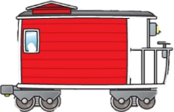

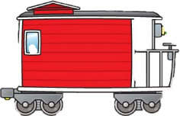
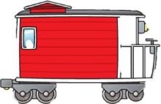
Mission for Integrated Development of Horticulture
Government of India focus on Horticulture started with CDB in 1981, followed by NHB (1984), TMNEH (2001),NHM & NBM (2005) and CIH (2006)
Individual schemes subsumed into MIDH
HMNEH
2001-02, as TMNE for horticulture (in north eastern states)
2003-04, added Himalayan States
CIH
2006-07, for HRD in Horticulture
CDB
1981: Coconut Development
2014
1981
1984
2001
2005
2006
NHB
1984: commercial horticulture
NHM
2005-06, mission to give direction & promote development of horticulture (in 18 states).
Various schemes integrated to harness the potential of horticulture in the country.
NBM
2005-06, focus on bamboo (all states).
Notes:
The time lines indicate a series of interventions implemented over previous 3 decades, with increasing focus on horticulture.
Culminating in the current state where integration of efforts and holistic development is envisaged.

Slide 53
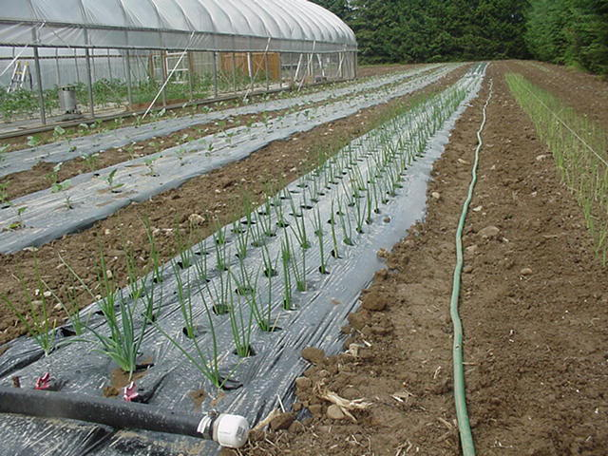
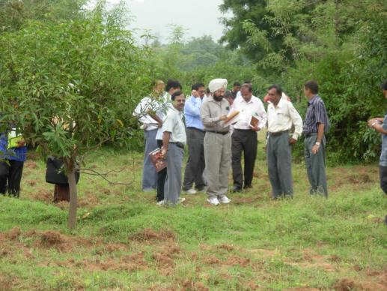
Mission Objectives
Mission aims at holistic development of horticulture.
Mission focuses area specific regionally differentiated strategies.
Enhance production, productivity, quality of produce, farmers income and nutritional security.
Aggregation of farmers into FIG/FPO for economy of scale and linking them directly to market.
Skill development and employment generation.

Slide 54
Horticulture-Driver for development
Livelihood support to women, small & marginal farmers.
Greater scope to improve resource use on small holdings.
Opens avenues for crop diversification, integrated farming and enhanced income to farmers.
Offers higher cash flow through shorter harvest cycles.
Promotes higher productivity on smaller land area and through protected cultivation.
In India, horticulture output has surpassed conventional agriculture in value and volume since 2013.

Slide 55
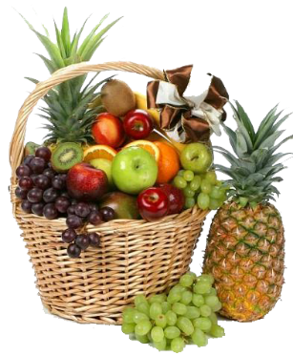
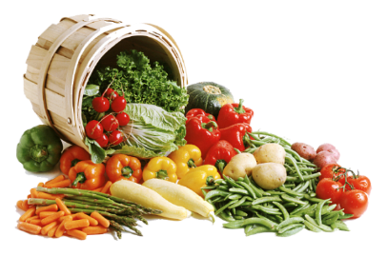
Support required
Enhanced allocation to Horticulture and cold-chain development.
Further emphasis on cold-chain as thrust area.
Adequate and trained manpower at state missions and horticulture departments.
Access and availability of credit for entrepreneur driven projects especially in NE, Hilly and Tribal regions.
Priority to Horticulture for Infrastructure connectivity - road, rail and electricity.

